Slide 1
Azure Container Services Overview

Slide 2



Table of contents
Azure Container Registry
Open source community
Azure Container Service (AKS)
Release automation tools
Containers 101
Getting started
Azure container technology
Open Service Broker for Azure (OSBA)
Customer success stories
Container orchestration
Azure Container Instances (ACI)

Slide 3
Containers 101
Azure Container Registry
Open source community
Azure Container Service (AKS)
Release automation tools
Containers 101
Getting started
Azure container technology
Open Service Broker for Azure (OSBA)
Customer success stories
Container orchestration
Azure Container Instances (ACI)

Slide 4
What we hear from developers
I need to create applications at a competitive rate without worrying about IT
New applications run smoothly on my machine but malfunction on traditional IT servers
My productivity and application innovation become suspended when I have to wait on IT

Slide 5
What we hear from IT
I need to manage servers and maintain compliance with little disruption
I’m unsure of how to integrate unfamiliar applications, and I require help from developers
I’m unable to focus on both server protection and application compliance

Slide 6
What is a container?
Containers = operating system virtualization
Traditional virtual machines = hardware virtualization
OS
Application
VM
VM
VM
Applications
Container
Container
Container
App
App
App
Kernel
OS
OS
OS
OS
Hardware
Hardware
Windows Server containers: maximum speed and density
Hyper-V containers: isolation plus performance
Container
Container
Container
Container
Container
Container
Kernel
Kernel
Kernel
Hardware
Hyper-V

Slide 7
Virtualization versus containerization
Virtual machine
Container
Application XYZ
Application
App dependencies
Dependencies
Guest OS
C
C
C
C
C
VM
VM
VM
VM
VM
VM
Dependency 1
Dependency 2
Hypervisor 2
Docker Engine
Hypervisor 1
Host OS
Host OS
Hardware
Hardware
Hardware
Type 1
Type 2
Virtualization
Containerization

Slide 8
The container advantage
Traditional virtualized environment
VM
VM
Low utilization of container resources
Application
Con.
Con.
Application
Containerization of applications and their dependencies
Con.
Con.
Hypervisor 2
Host OS
Hardware

Slide 9
The container advantage
Containerized environment
Migrate containers and their dependencies to underutilized VMs for improved density and isolation
VM
VM
Con.
Con.
Decommission unused resources for efficiency gains and cost savings
Con.
Con.
Docker Engine
Host OS
Hardware

Slide 10

The container advantage
Fast iteration
Agile delivery
Immutability
Cost savings
Efficient deployment
Elastic bursting
For developers
For IT

Slide 11


Containers are gaining momentum
Does your organization currently use container technologies?¹
23%
My org. is evaluating container technologies
Yes, my org. currently uses container technologies
No, my org. is not using container technologies
Not sure
Not applicable
Larger companies are leading adoption.²
42%
~60%
25%
7%
Nearly 60% percent of organizations running 500 or more hosts are classiﬁed as container dabblers or adopters.
2%
The average company QUINTUPLES its container usage within 9 months.¹
Container hosts often run SEVEN containers at a time.¹
Containers churn 9 times FASTER than VMs.¹
5x
7x
9x
Source:
1: Datadog: 8 Surprising Facts About Real Docker Adoption; 2: DZone: The DZone Guide to Deploying and Orchestrating Containers

Slide 12


Industry analysts agree
“By 2020, more than 50% of enterprises will run mission-critical, containerized cloud-native applications in production, up from less than 5% today.”

Slide 13

Container orchestration
Azure Container Registry
Open source community
Azure Container Service (AKS)
Release automation tools
Containers 101
Getting started
Azure container technology
Open Service Broker for Azure (OSBA)
Customer success stories
Container orchestration
Azure Container Instances (ACI)

Slide 14
The elements of orchestration
Scheduling
Affinity/anti-affinity
Health monitoring
Failover
Scaling
Networking
Service discovery
Coordinated app upgrades

Slide 15
Kubernetes: the de-facto orchestrator
Portable
Public, private, hybrid, multi-cloud
Extensible
Modular, pluggable, hookable, composable
Self-healing
Auto-placement, auto-restart, auto-replication, auto-scaling

Slide 16
Kubernetes: empowering you to do more
Deploy your applications quickly and predictably
Scale your applications on the fly
Roll out new features seamlessly
Limit hardware usage to required resources only

Slide 17
Azure container technology
Azure Container Registry
Open source community
Azure Container Service (AKS)
Release automation tools
Containers 101
Getting started
Azure container technology
Open Service Broker for Azure (OSBA)
Customer success stories
Container orchestration
Azure Container Instances (ACI)

Slide 18
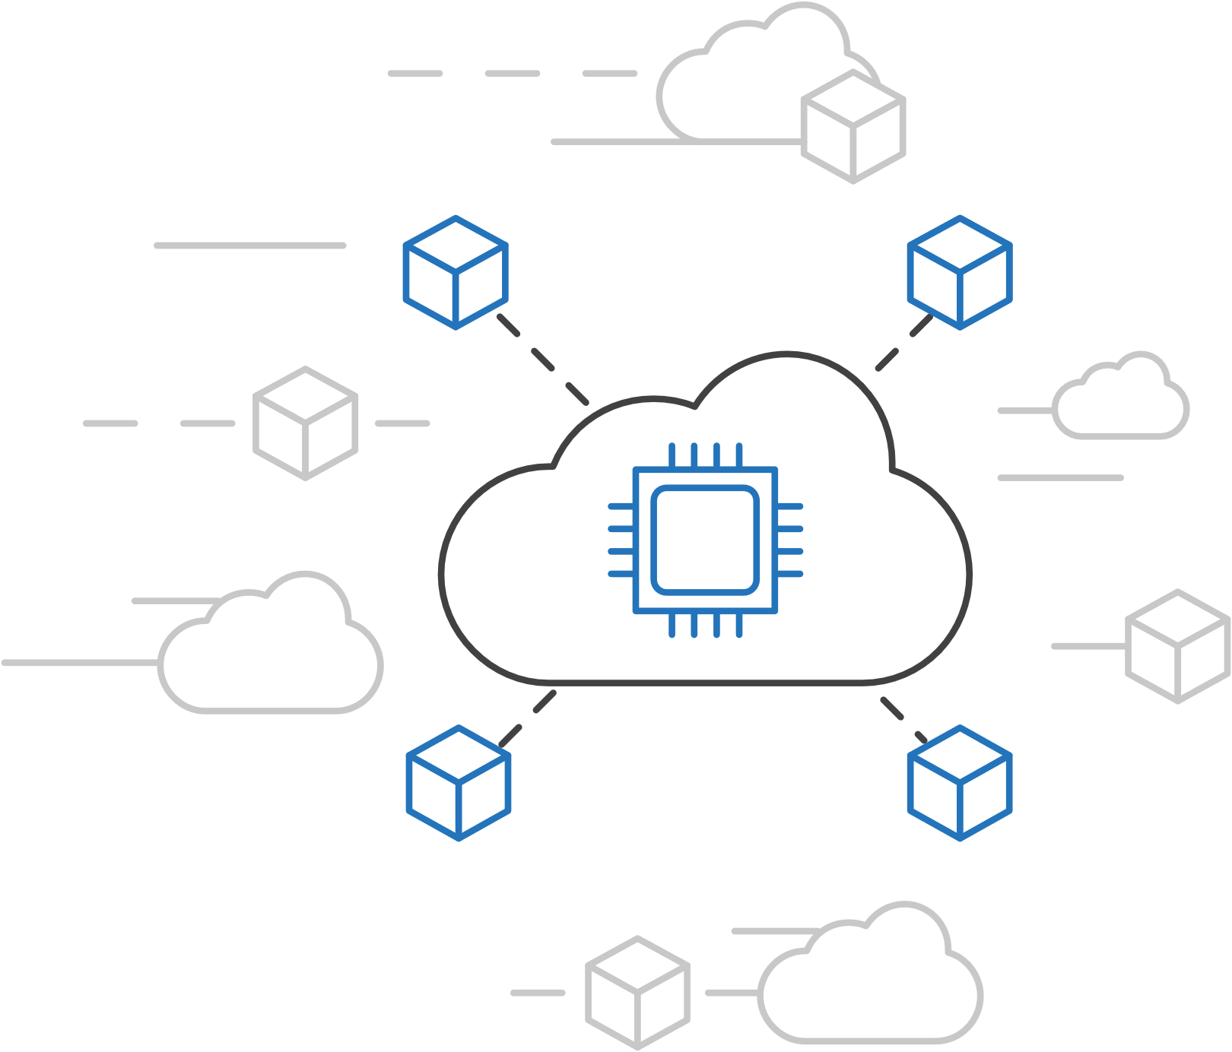
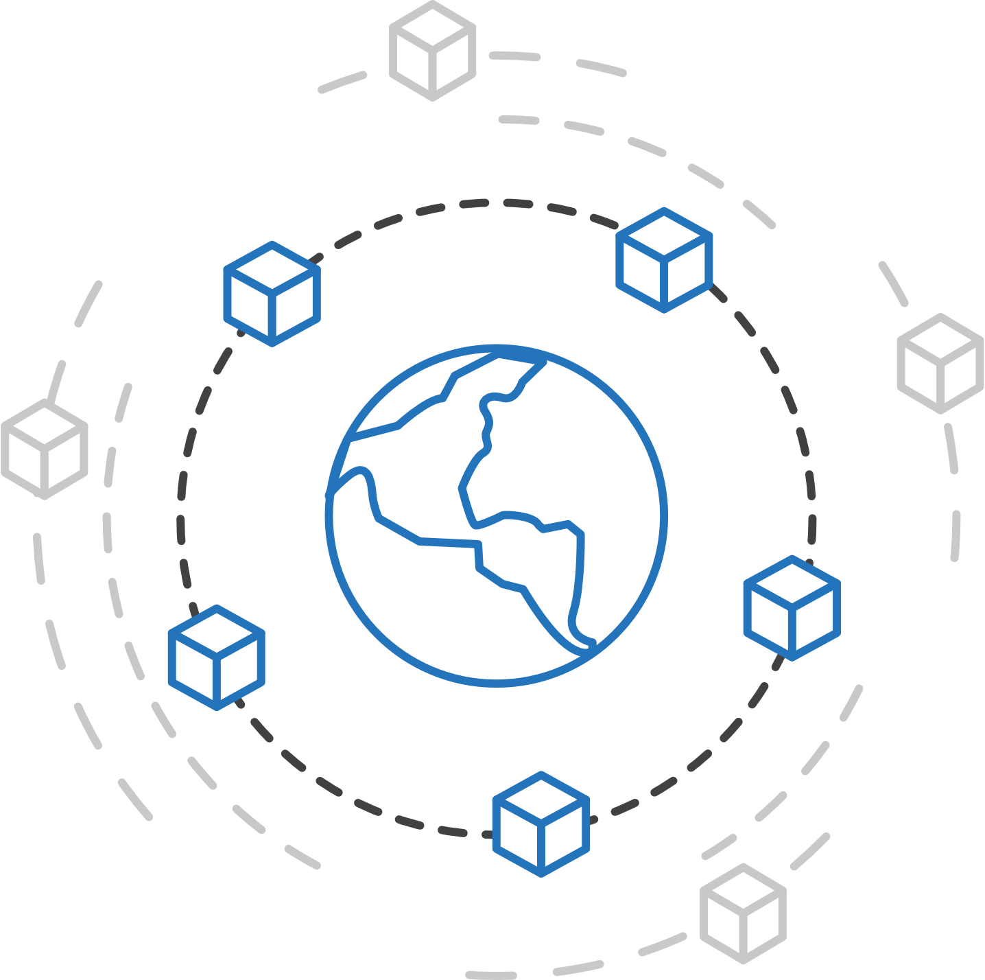
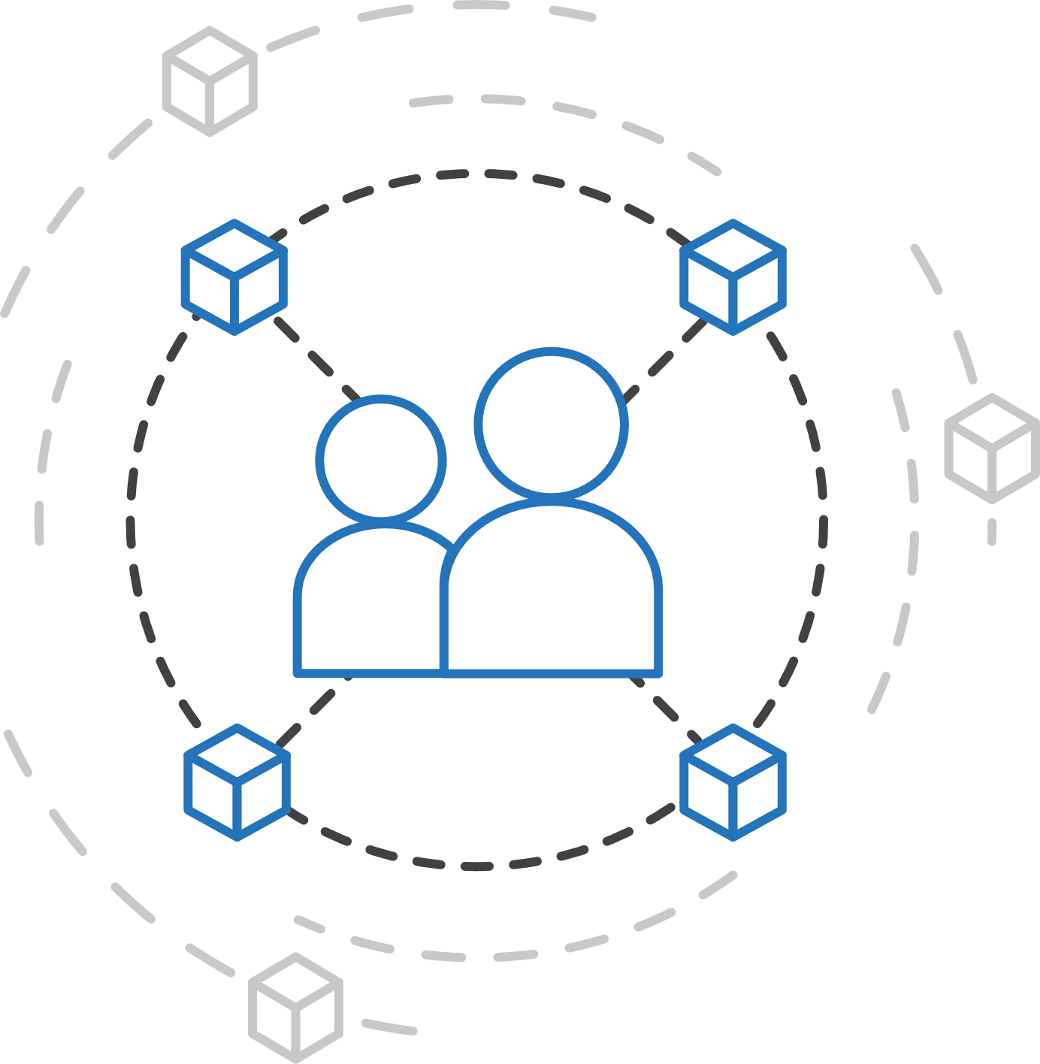
Azure container strategy
Embrace containers as ubiquitous
Support containers across the compute portfolio
Democratize container technology

Slide 19



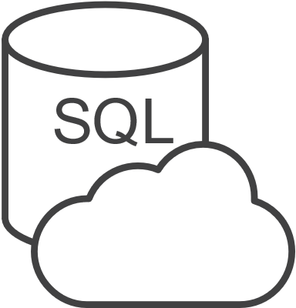



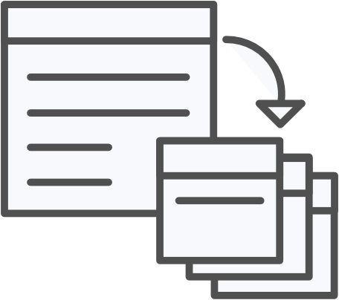





Azure container ecosystem
OSBA
App Service
Azure Container Registry (ACR)
Partner services
Azure services
PaaS
OpenShift
SQL Database
Azure Container Service (AKS)
Service Fabric
Batch
Pivotal Cloud Foundry
Redis Cache
ACS Engine
Docker Enterprise Edition
CosmosDB
Virtual kubelet
Mesosphere DC/OS
And more!
Azure Container Instances (ACI)
Azure Virtual Machines
Virtual Machine Scale Sets (VMSS)
Azure
IaaS

Slide 20
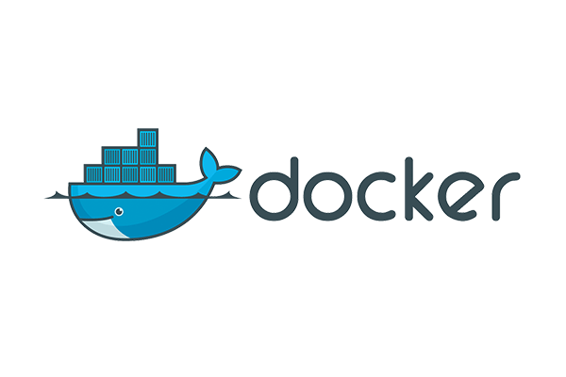



If you have a preferred container platform Pivotal Cloud Foundry  Kubernetes  Docker Enterprise Edition Red Hat OpenShift  Mesosphere DC/OS
Lets help you bring that platform to Azure

Slide 21
If you are without a preferred container platform…
Lets profile your needs and help you select the right option

Slide 22
Azure Container Service (AKS)
Azure Container Registry
Open source community
Azure Container Service (AKS)
Release automation tools
Containers 101
Getting started
Azure container technology
Open Service Broker for Azure (OSBA)
Customer success stories
Container orchestration
Azure Container Instances (ACI)

Slide 23

Azure Container Service (AKS)
Azure Container Service (AKS)
Azure Container Instances (ACI)
OSBA
App Service
Azure Container Registry (ACR)
Partner services
Azure services
PaaS
Azure Container Registry
OpenShift
SQL Database
Azure Container Service (AKS)
Service Fabric
Batch
Pivotal Cloud Foundry
Redis Cache
ACS Engine
Open Service Broker API (OSBA)
Docker Enterprise Edition
CosmosDB
Virtual kubelet
Mesosphere DC/OS
And more!
Azure Container Instances (ACI)
Azure Virtual Machines
Virtual Machine Scale Sets (VMSS)
Release Automation Tools
Azure
IaaS

Slide 24
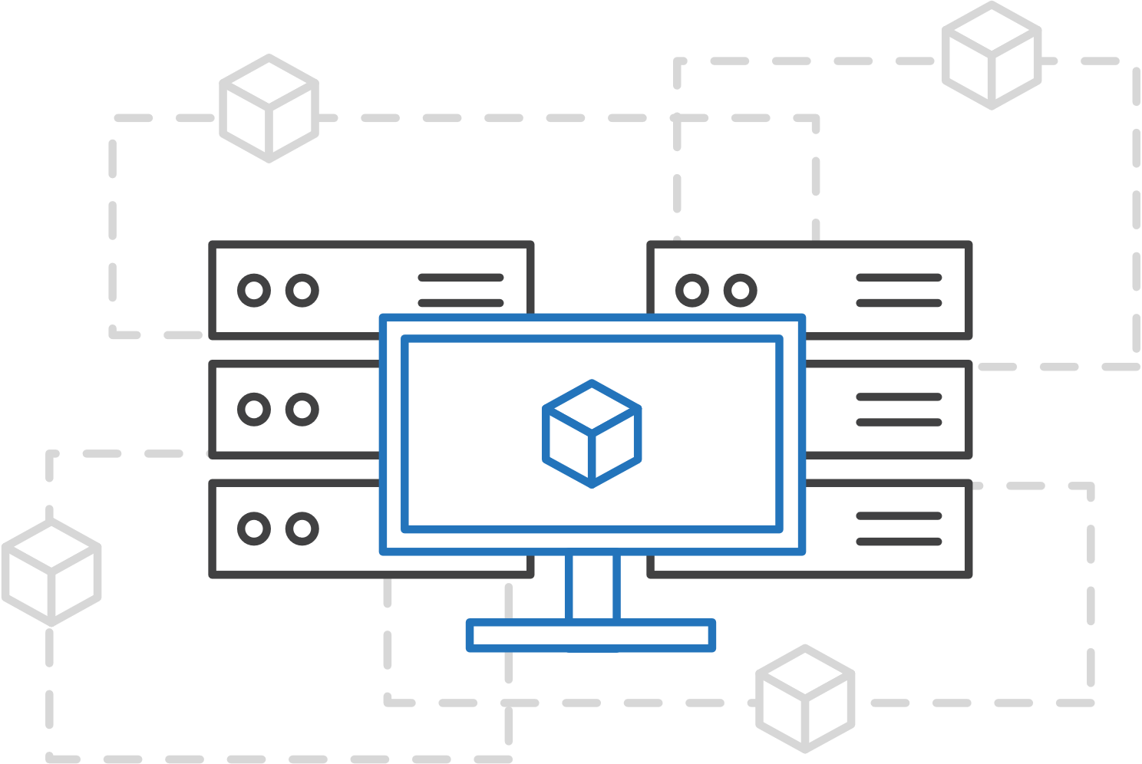

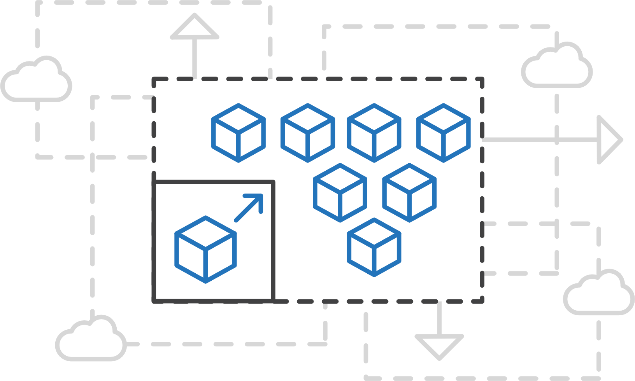
Azure Container Service (AKS)
Azure Container Service (AKS)
Simplify the deployment, management, and operations of Kubernetes
Azure Container Instances (ACI)
Azure Container Registry
Open Service Broker API (OSBA)
Focus on your containers not the infrastructure
Work how you want with open-source APIs
Scale and run applications with confidence
Release Automation Tools

Slide 25
Azure Container Service (AKS)
Azure Container Service (AKS)
A fully managed Kubernetes cluster
Azure Container Instances (ACI)
Managed control pane
Automated upgrades, patches
Easy cluster scaling
Self-healing
Cost savings
Azure Container Registry
Managed
Application architect
Applications
Open Service Broker API (OSBA)
Operations
Kubernetes
Infrastructure architect
Docker
Release Automation Tools
Azure infrastructure services

Slide 26
Azure Container Service (AKS)
Azure Container Service (AKS)
Get started easily
Azure Container Instances (ACI)
$ az aks create -g myResourceGroup -n myCluster --generate-ssh-keys
\ Running ..
$ az aks install-cli
Downloading client to /usr/local/bin/kubectl ..
$ az aks get-credentials -g myResourceGroup -n myCluster
Merged "myCluster" as current context ..
$ kubectl get nodes
NAME STATUS AGE VERSION
aks-mycluster-36851231-0 Ready 4m v1.8.1
aks-mycluster-36851231-1 Ready 4m v1.8.1
aks-mycluster-36851231-2 Ready 4m v1.8.1
Azure Container Registry
Open Service Broker API (OSBA)
Release Automation Tools

Slide 27
Azure Container Service (AKS)
Azure Container Service (AKS)
Manage an AKS cluster
Azure Container Instances (ACI)
$ az aks list –o table
Name Location ResourceGroup KubernetesRelease ProvisioningState
------------------ ---------- -------------- ------------------- -------------------
myCluster westus2 myResourceGroup 1.7.7 Succeeded
$ az aks upgrade -g myResourceGroup -n myCluster –-kubernetes-version 1.8.1
\ Running ..
$ kubectl get nodes
NAME STATUS AGE VERSION
aks-mycluster-36851231-0 Ready 12m v1.8.1
aks-mycluster-36851231-1 Ready 8m v1.8.1
aks-mycluster-36851231-2 Ready 3m v1.8.1
$ az aks scale -g myResourceGroup -n myCluster --agent-count 10
\ Running ..
Azure Container Registry
Open Service Broker API (OSBA)
Release Automation Tools

Slide 28
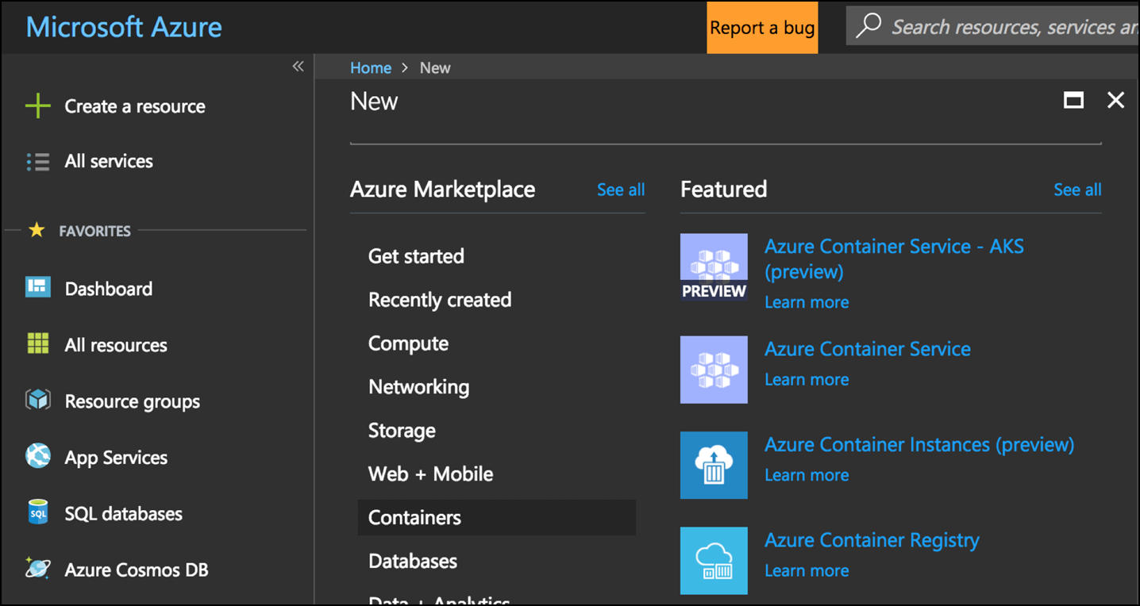
Azure Container Service (AKS)
Azure Container Service (AKS)
Create an AKS cluster via the Azure portal
Azure Container Instances (ACI)
Azure Container Registry
Open Service Broker API (OSBA)
Release Automation Tools

Slide 29
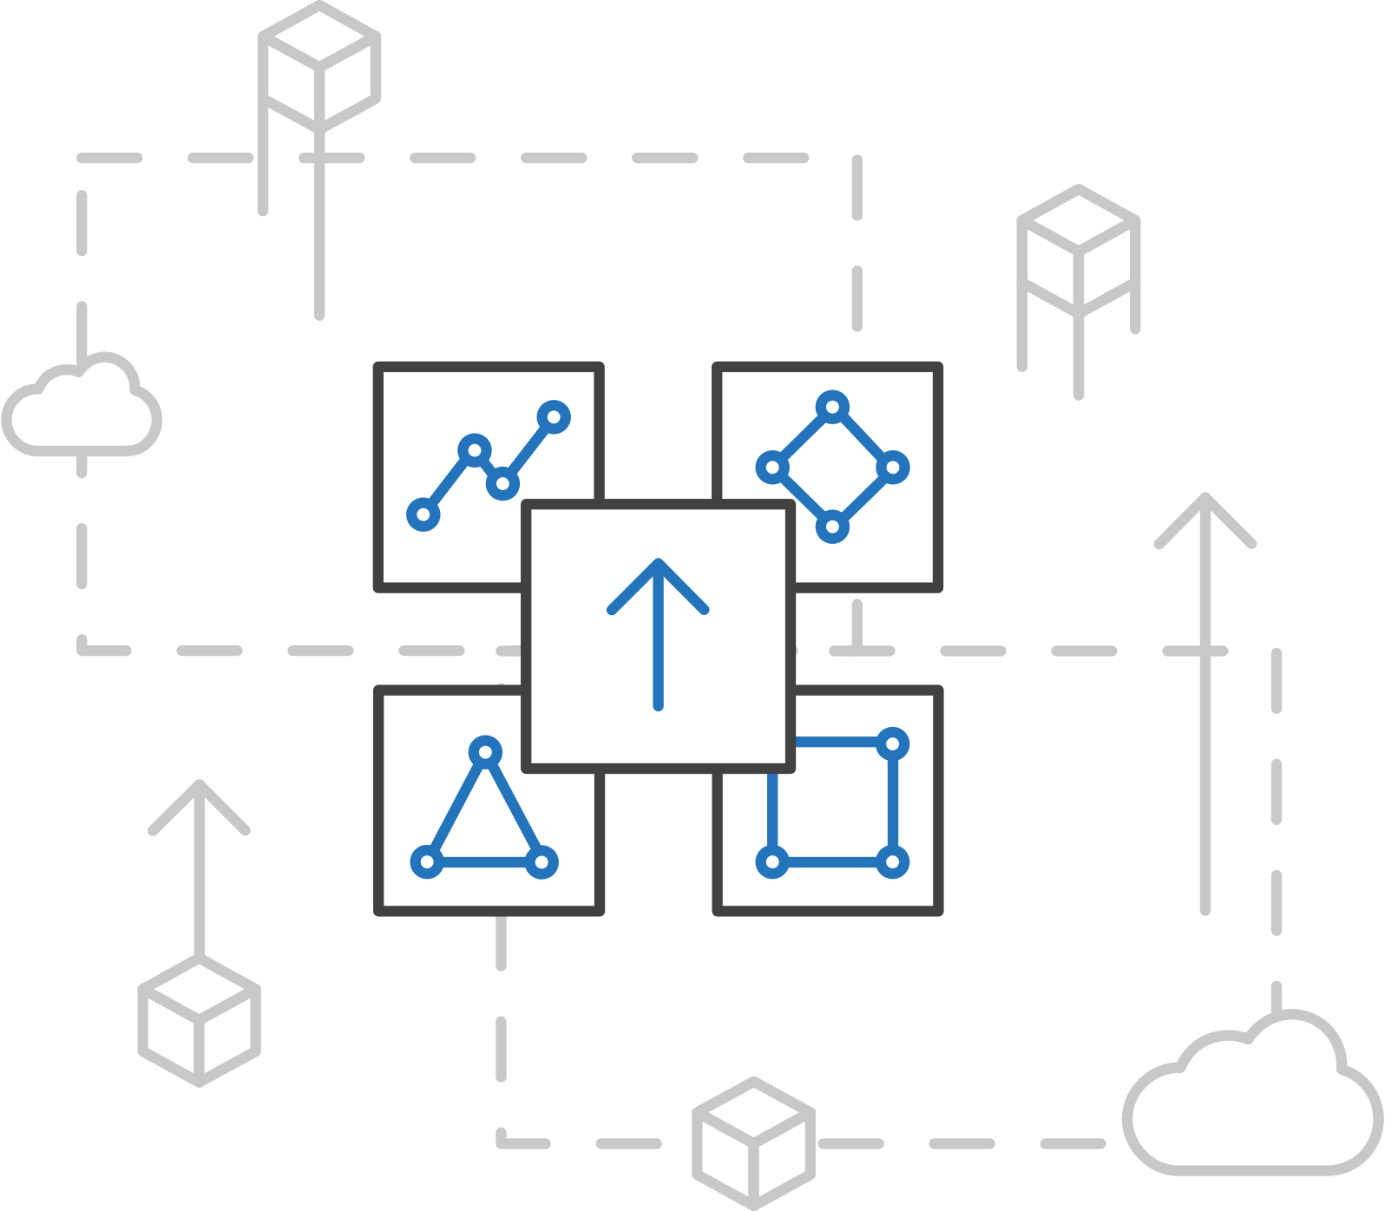
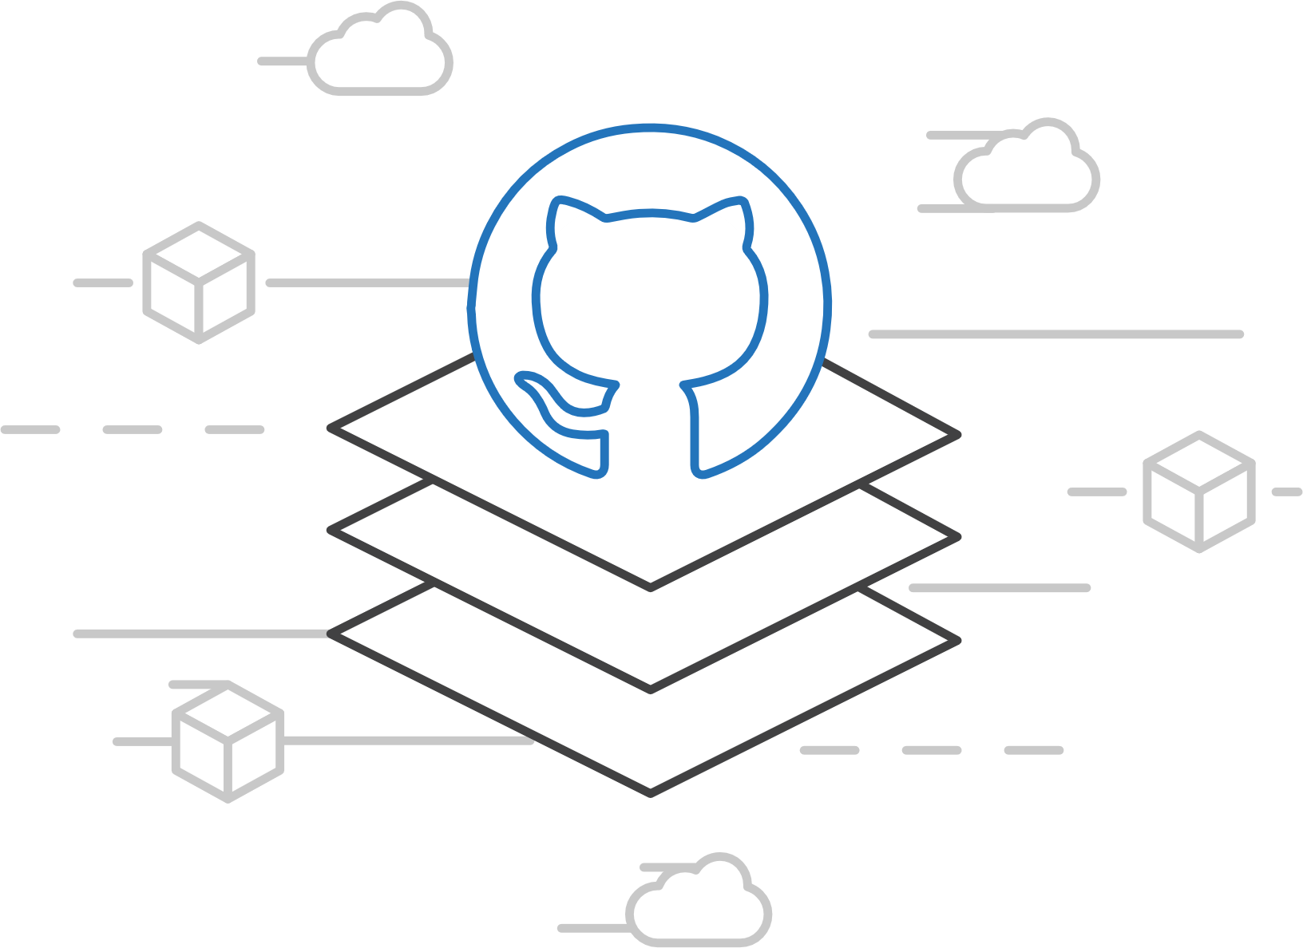
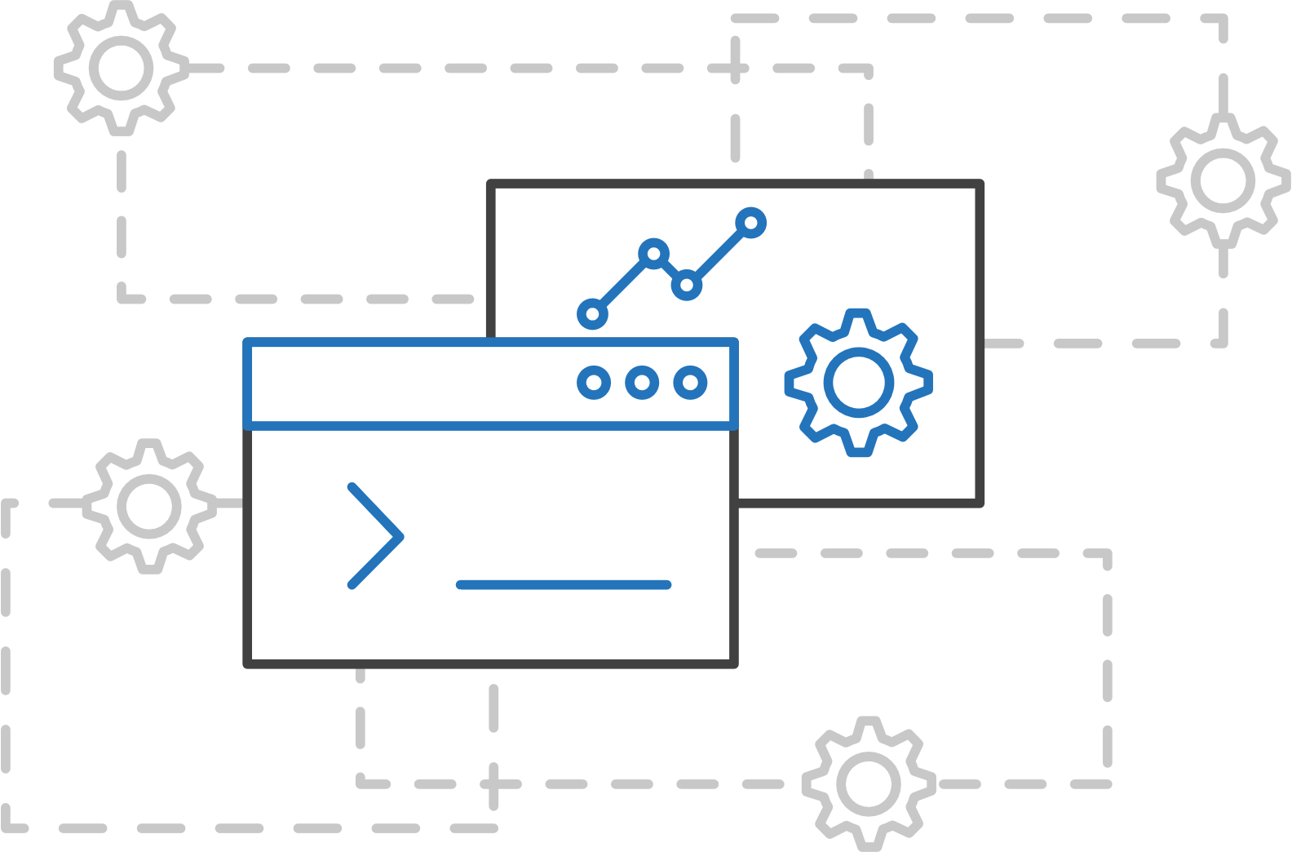
Azure Container Service (AKS)
Azure Container Service (AKS)
Azure Container Service Engine
Azure Container Instances (ACI)
Azure Container Registry
Open Service Broker API (OSBA)
A proving ground for new features
Enables custom deployments
Available on GitHub
Release Automation Tools

Slide 30
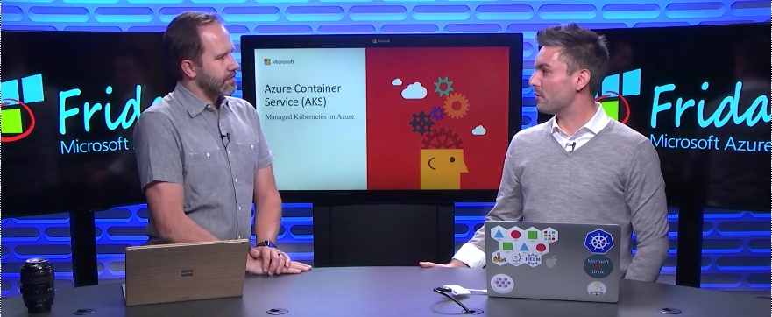
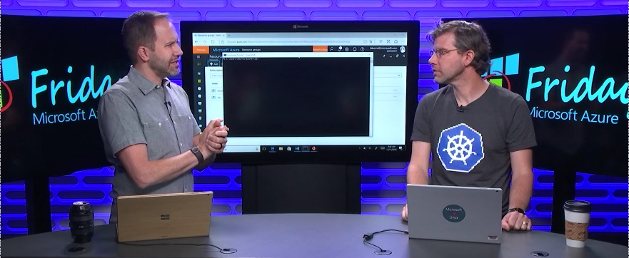
Azure Container Service (AKS)
Azure Container Service (AKS)
Resources
Azure Container Instances (ACI)
Azure Container Service (AKS) webpage
AKS videos
AKS technical documentation
AKS pricing details
AKS roadmap
Azure Container Service Engine: Github
Container Orchestration Simplified with AKS
Azure Container Registry
Open Service Broker API (OSBA)
Kubernetes Support in Azure Container Services
Release Automation Tools

Slide 31
Azure Container Instances (ACI)
Azure Container Registry
Open source community
Azure Container Service (AKS)
Release automation tools
Containers 101
Getting started
Azure container technology
Open Service Broker for Azure (OSBA)
Customer success stories
Container orchestration
Azure Container Instances (ACI)

Slide 32
Azure Container Instances (ACI)
Azure Container Service (AKS)
Azure Container Instances (ACI)
OSBA
App Service
Azure Container Registry (ACR)
Partner services
Azure services
PaaS
Azure Container Registry
OpenShift
SQL Database
Azure Container Service (AKS)
Service Fabric
Batch
Pivotal Cloud Foundry
Redis Cache
ACS Engine
Open Service Broker API (OSBA)
Docker Enterprise Edition
CosmosDB
Virtual kubelet
Mesosphere DC/OS
And more!
Azure Container Instances (ACI)
Azure Virtual Machines
Virtual Machine Scale Sets (VMSS)
Release Automation Tools
Azure
IaaS

Slide 33
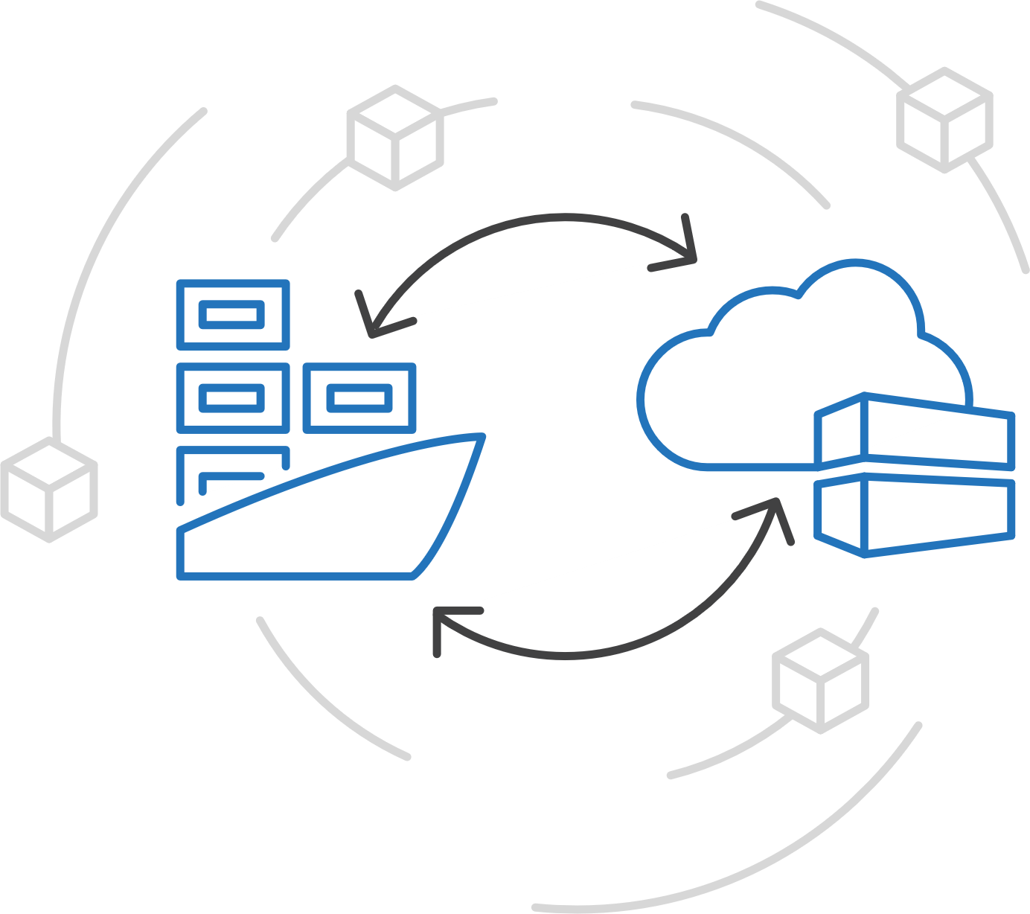
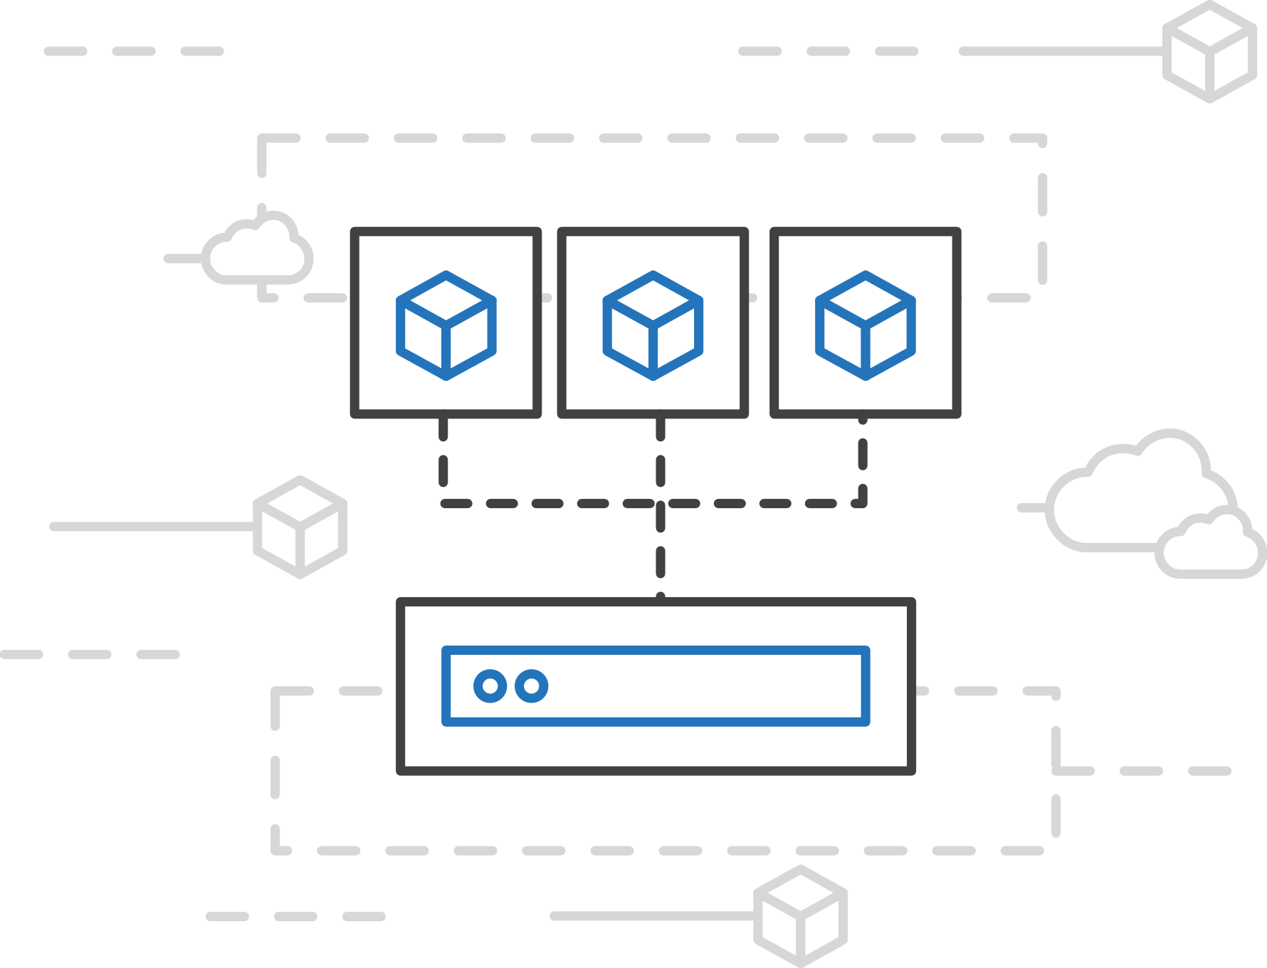
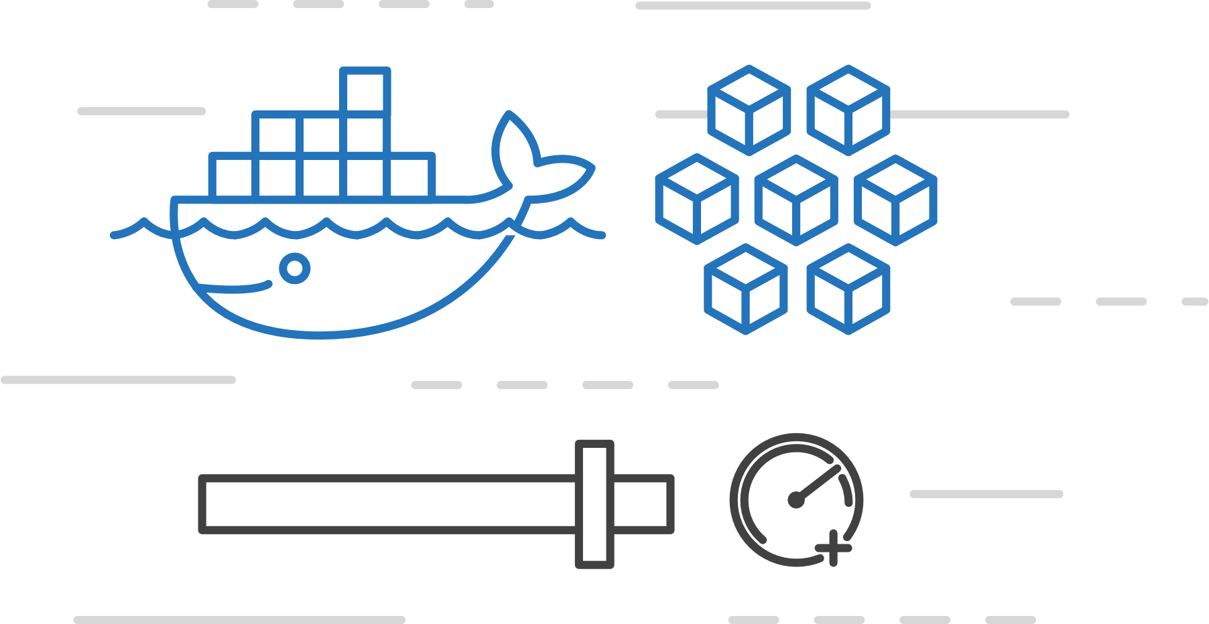
Azure Container Instances (ACI)
Azure Container Service (AKS)
Easily run containers on Azure with a single command
Azure Container Instances (ACI)
Azure Container Registry
Open Service Broker API (OSBA)
Start using containers right away
Cloud-scale container capacity
Hyper-visor isolation
Release Automation Tools

Slide 34
Azure Container Instances (ACI)
Azure Container Service (AKS)
Get started easily
Azure Container Instances (ACI)
$ az container create --name mycontainer --image microsoft/aci-helloworld --resource-group myResourceGroup --ip-address public
"ipAddress": {
"ip": "52.168.86.133",
"ports": [...]
},
"location": "eastus",
"name": "mycontainer",
"osType": "Linux",
"provisioningState": "Succeeded",
$ curl 52.168.86.133
<html>
<head>
<title>Welcome to Azure Container Instances!</title>
</head>
Azure Container Registry
Open Service Broker API (OSBA)
Release Automation Tools

Slide 35
Azure Container Instances (ACI)
Azure Container Service (AKS)
Create an Azure Container Instance quickly
Azure Container Instances (ACI)
Azure Container Registry
Open Service Broker API (OSBA)
Release Automation Tools

Slide 36
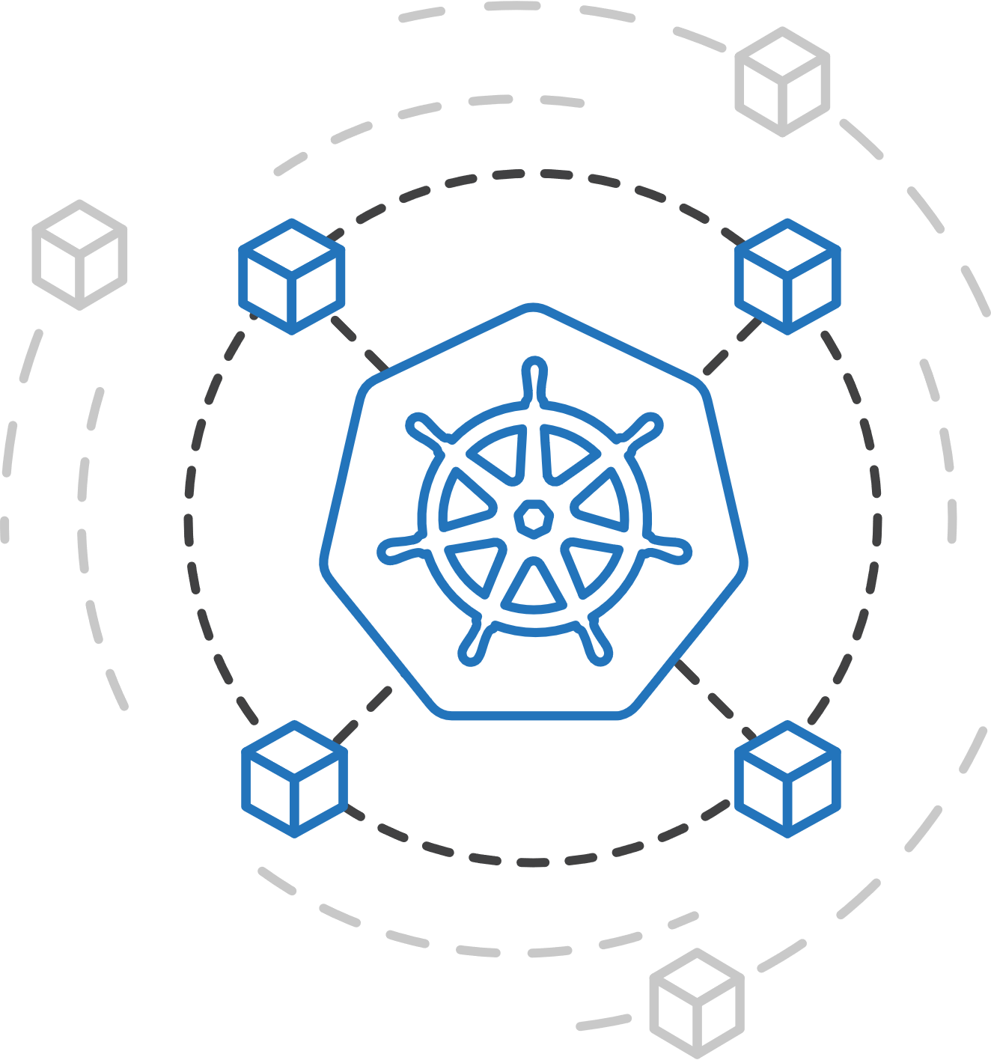
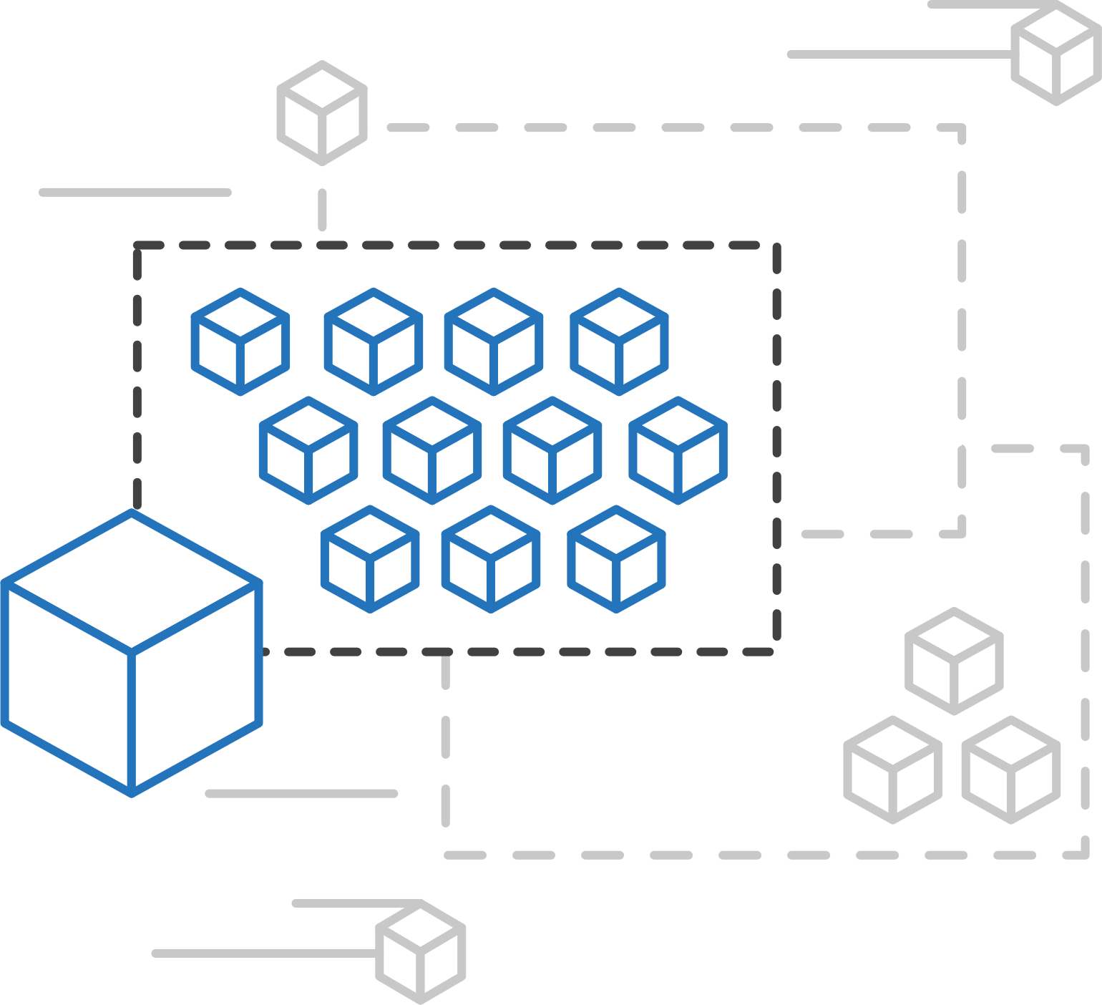
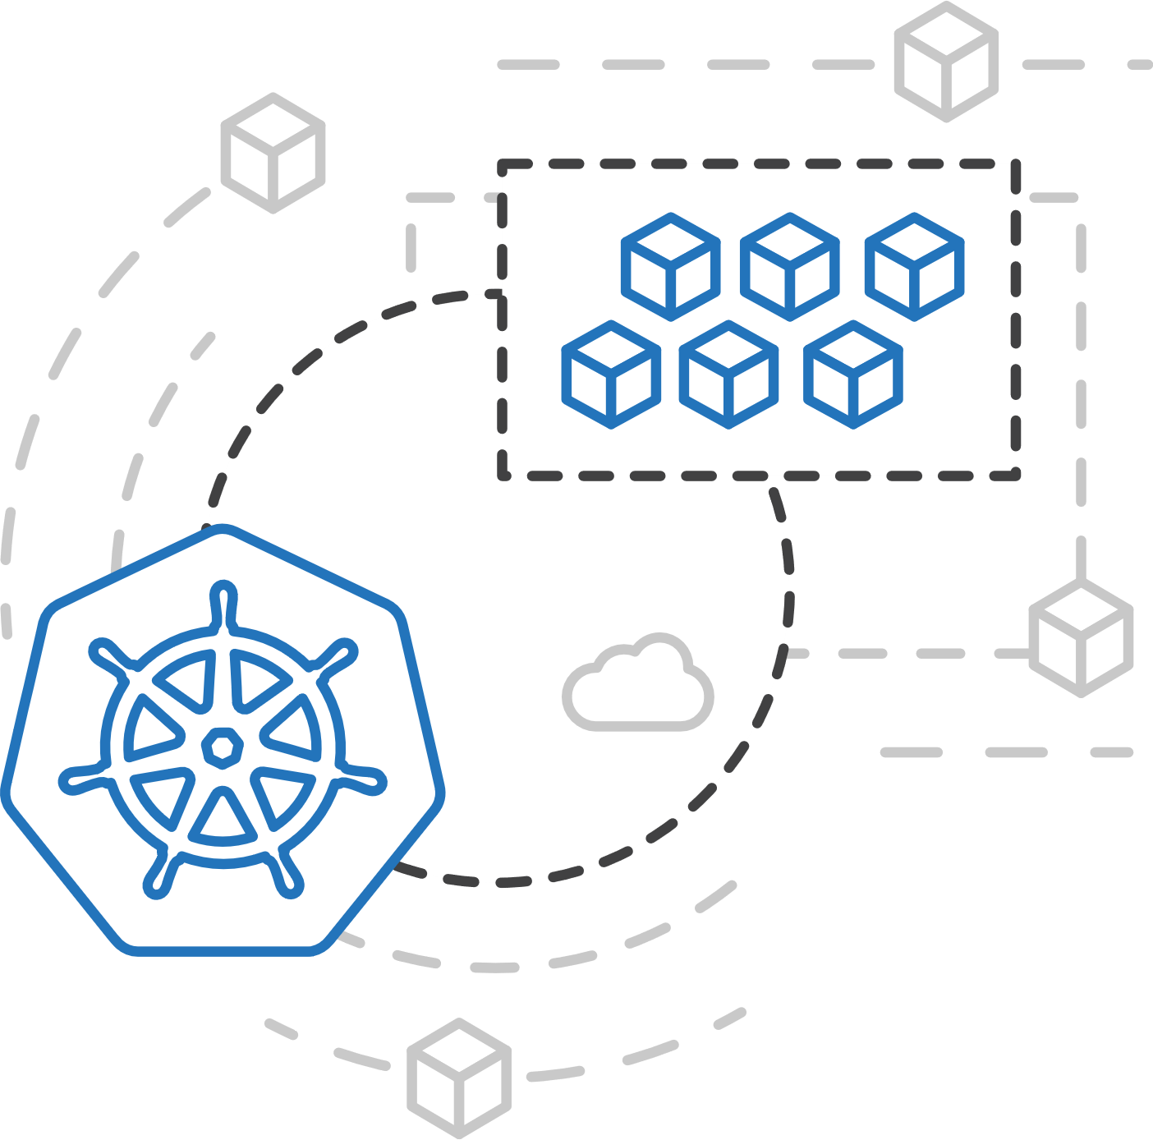
Azure Container Service (AKS)
Azure Container Instances (ACI)
ACI Connector for Kubernetes
Azure Container Instances (ACI)
Azure Container Registry
Open Service Broker API (OSBA)
Kubernetes provides rich orchestration capabilities
ACI provides infinite container-based scale
The ACI Connector for K8s brings them together
Release Automation Tools

Slide 37
Azure Container Instances (ACI)
Azure Container Service (AKS)
Bursting with the ACI Connector
Azure Container Instances (ACI)
VM
VM
Pod
Waste
Pod
Pod
Pod
Waste
Pod
Pod
Pod
Pod
Azure Container Registry
Azure Container Instances (ACI)
Pod
Pod
Pod
Pod
Pod
Application architect
Kubernetes control pane
ACI Connector
Pod
Pod
Pod
Pod
Pod
Pod
Pod
Pod
Pod
Pod
Open Service Broker API (OSBA)
Pod
Pod
Pod
Pod
Pod
Deployment/ tasks
Pod
Pod
Pod
Pod
Pod
Infrastructure architect
Release Automation Tools
Pod
Waste
Pod
Pod
Pod
Waste
Pod
Pod
Pod
Pod
VM
VM

Slide 38
Azure Container Service (AKS)
Azure Container Instances (ACI)
Virtual Kubelet
Azure Container Instances (ACI)
Kubernetes API
Azure Container Registry
Node
Node
Node
Node
virtual kubelet
Kubelet
Kubelet
Kubelet
Kubelet
Open Service Broker API (OSBA)
Release Automation Tools
Typical kubelets implement the pod and container operations for each node as usual.
Virtual kublet registers itself as a “node” and allows developers to program their own behaviors for operations on pods and containers.

Slide 39
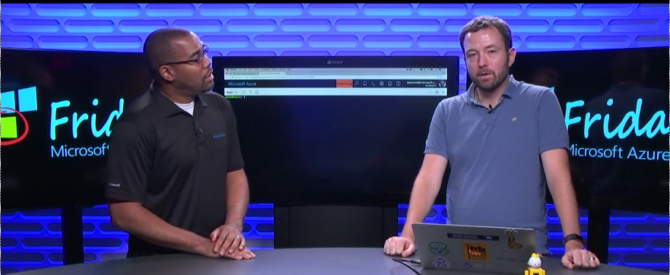
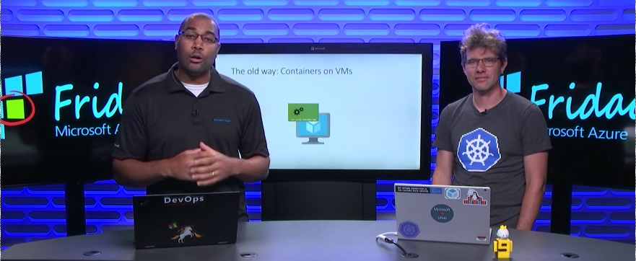
Azure Container Instances (ACI)
Azure Container Service (AKS)
Resources
Azure Container Instances (ACI)
Azure Container Instances (ACI) webpage
ACI videos
ACI technical documentation
ACI pricing details
ACI roadmap
Azure Container Instances
Azure Container Registry
Open Service Broker API (OSBA)
Using Kubernetes with Azure Container Instances
Release Automation Tools

Slide 40
Azure Container Registry
Azure Container Registry
Open source community
Azure Container Service (AKS)
Release automation tools
Containers 101
Getting started
Azure container technology
Open Service Broker for Azure (OSBA)
Customer success stories
Container orchestration
Azure Container Instances (ACI)

Slide 41
Azure Container Registry
Azure Container Service (AKS)
Azure Container Instances (ACI)
OSBA
App Service
Azure Container Registry (ACR)
Partner services
Azure services
PaaS
Azure Container Registry
OpenShift
SQL Database
Azure Container Service (AKS)
Service Fabric
Batch
Pivotal Cloud Foundry
Redis Cache
ACS Engine
Open Service Broker API (OSBA)
Docker Enterprise Edition
CosmosDB
Virtual kubelet
Mesosphere DC/OS
And more!
Azure Container Instances (ACI)
Azure Virtual Machines
Virtual Machine Scale Sets (VMSS)
Release Automation Tools
Azure
IaaS

Slide 42
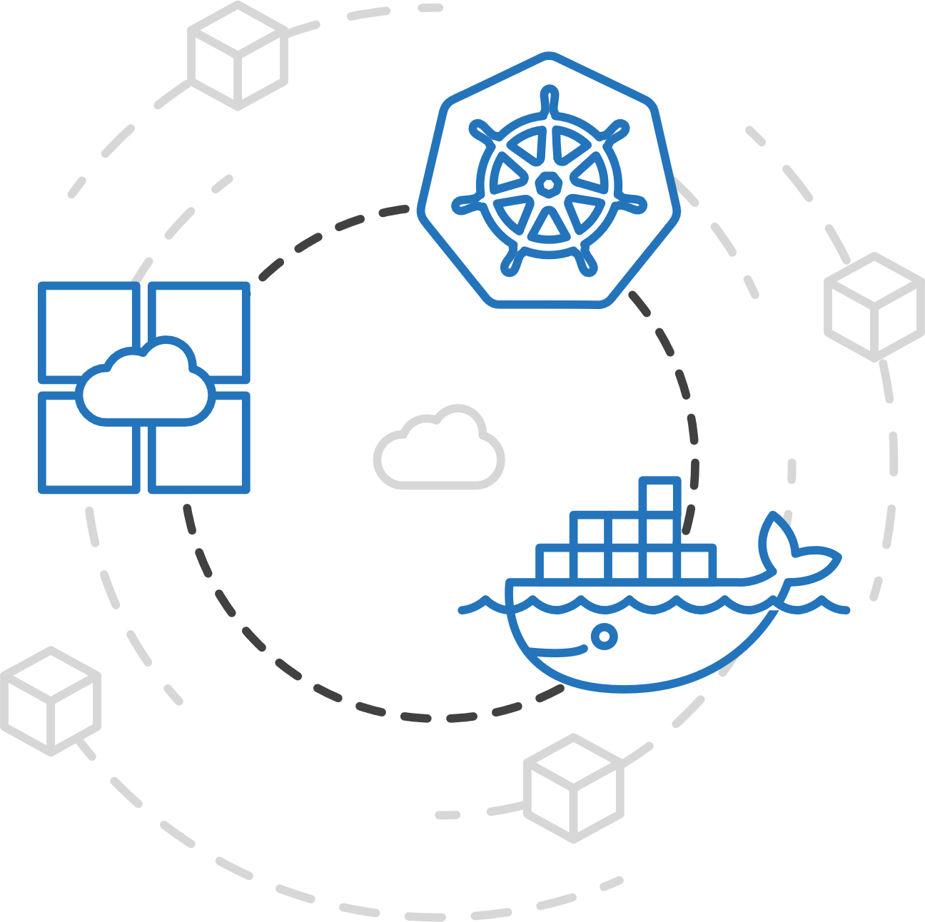

Azure Container Registry
Azure Container Service (AKS)
Manage a Docker private registry as a first-class Azure resource
Azure Container Instances (ACI)
Azure Container Registry
Open Service Broker API (OSBA)
Manage images for all types of containers
Use familiar, open-source Docker CLI tools
Azure Container Registry geo-replication
Release Automation Tools

Slide 43
Azure Container Registry
Azure Container Service (AKS)
Create a container in the Registry quickly
Azure Container Instances (ACI)
Azure Container Registry
Open Service Broker API (OSBA)
Release Automation Tools

Slide 44
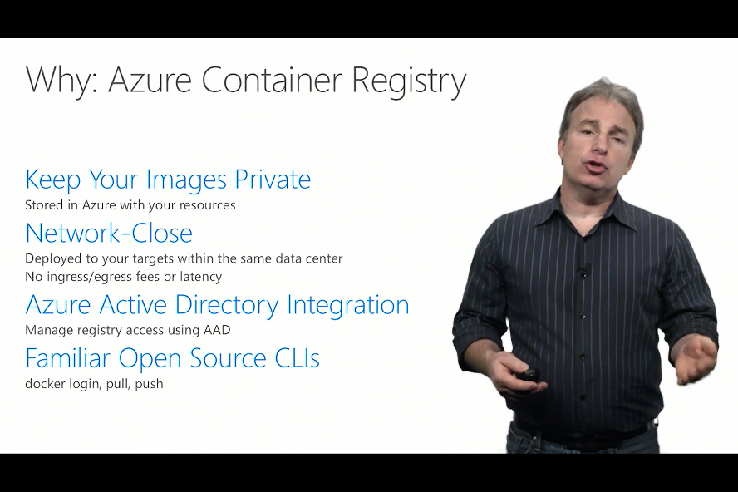
Azure Container Registry
Azure Container Service (AKS)
Resources
Azure Container Instances (ACI)
Azure Container Registry webpage
Registry technical documentation
Registry pricing details
Registry roadmap
Creating, configuring the Azure Container Registry
Azure Container Registry
Open Service Broker API (OSBA)
Release Automation Tools

Slide 45

Open Service Broker for Azure
Azure Container Registry
Open source community
Azure Container Service (AKS)
Release automation tools
Containers 101
Getting started
Azure container technology
Open Service Broker for Azure (OSBA)
Customer success stories
Container orchestration
Azure Container Instances (ACI)

Slide 46

Open Service Broker for Azure (OSBA)
Azure Container Service (AKS)
Azure Container Instances (ACI)
OSBA
App Service
Azure Container Registry (ACR)
Partner services
Azure services
PaaS
Azure Container Registry
OpenShift
SQL Database
Azure Container Service (AKS)
Service Fabric
Batch
Pivotal Cloud Foundry
Redis Cache
ACS Engine
Open Service Broker API (OSBA)
Docker Enterprise Edition
CosmosDB
Virtual kubelet
Mesosphere DC/OS
And more!
Azure Container Instances (ACI)
Azure Virtual Machines
Virtual Machine Scale Sets (VMSS)
Release Automation Tools
Azure
IaaS

Slide 47
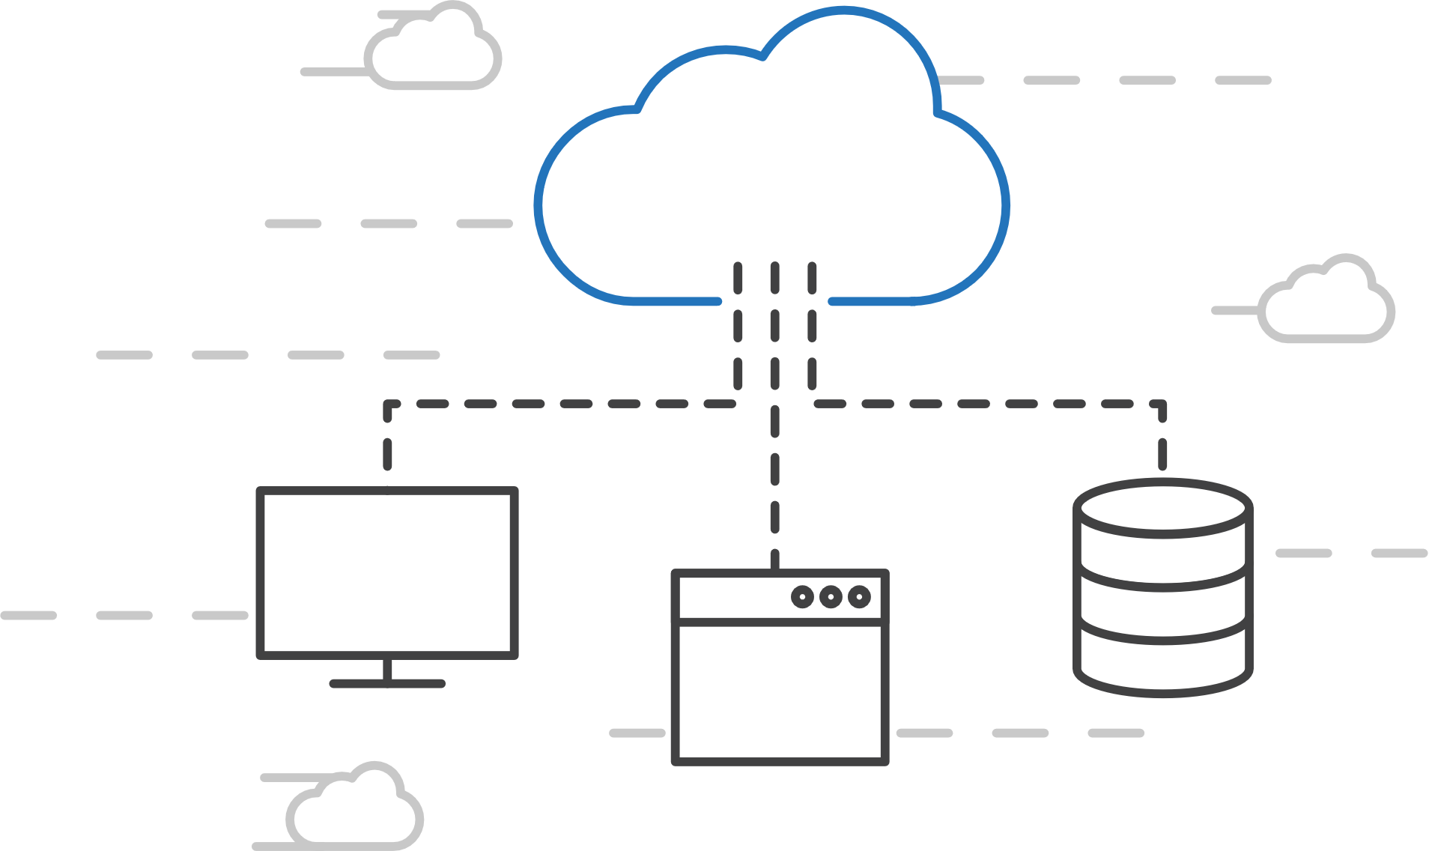

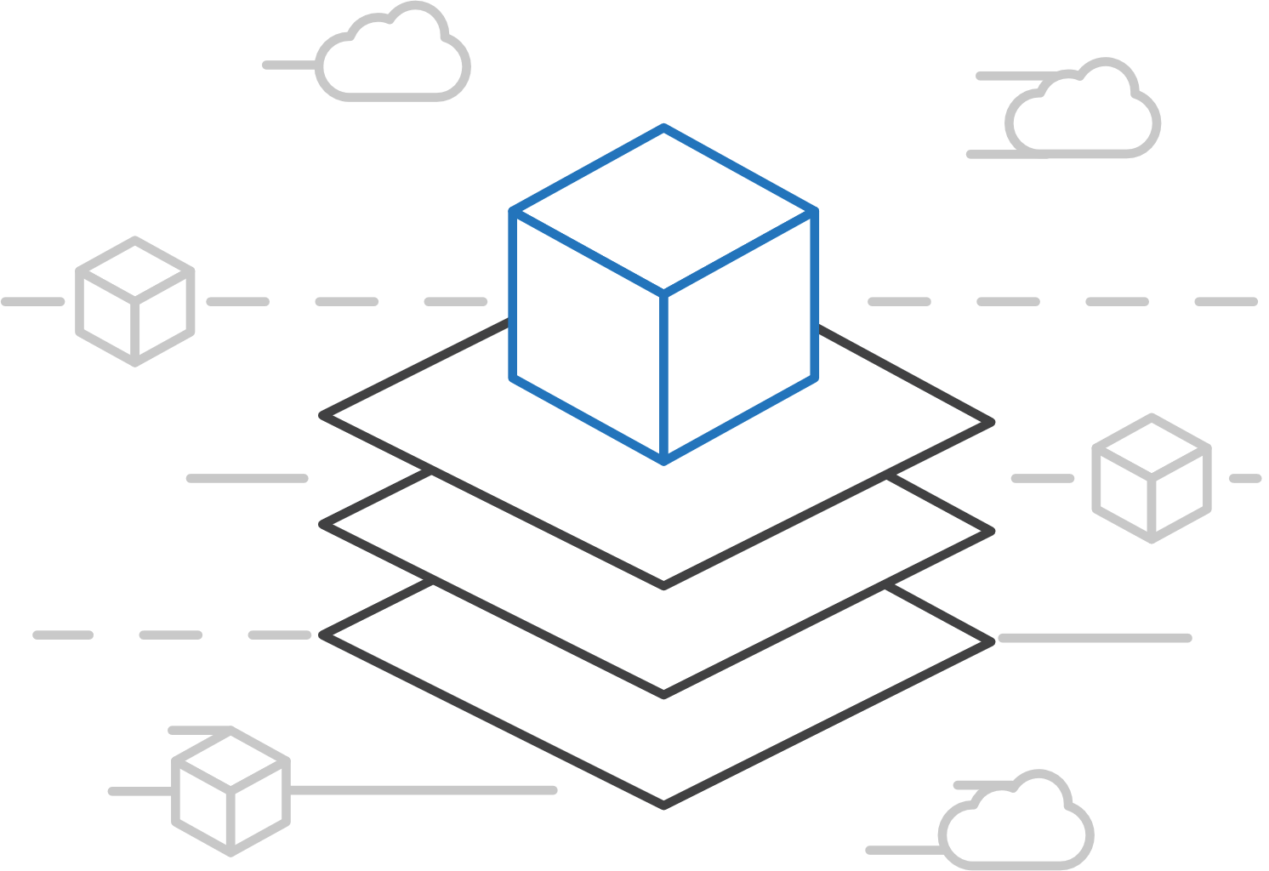
Open Service Broker for Azure (OSBA)
Azure Container Service (AKS)
Connecting containers to Azure services and platforms
Azure Container Instances (ACI)
Azure Container Registry
Open Service Broker API (OSBA)
A standardized way to connect with Azure services
Simple and flexible service integration
Compatible across numerous platforms
Release Automation Tools

Slide 48
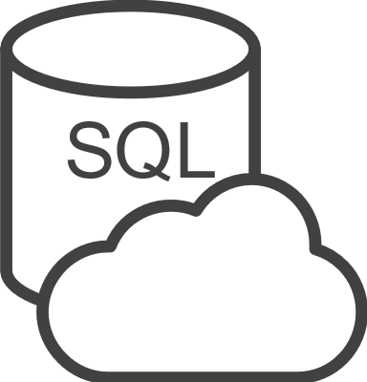






Open Service Broker for Azure (OSBA)
Azure Container Service (AKS)
An implementation of the Open Service Broker API
Azure Container Instances (ACI)
Azure SQL Database
Redis Cache
CosmosDB
And more!
Azure Container Registry
Open Service Broker for Azure (OSBA)
Open Service Broker API (OSBA)
Release Automation Tools
OpenShift
Cloud Foundry
Service Fabric (Coming soon)
Kubernetes (AKS)

Slide 49
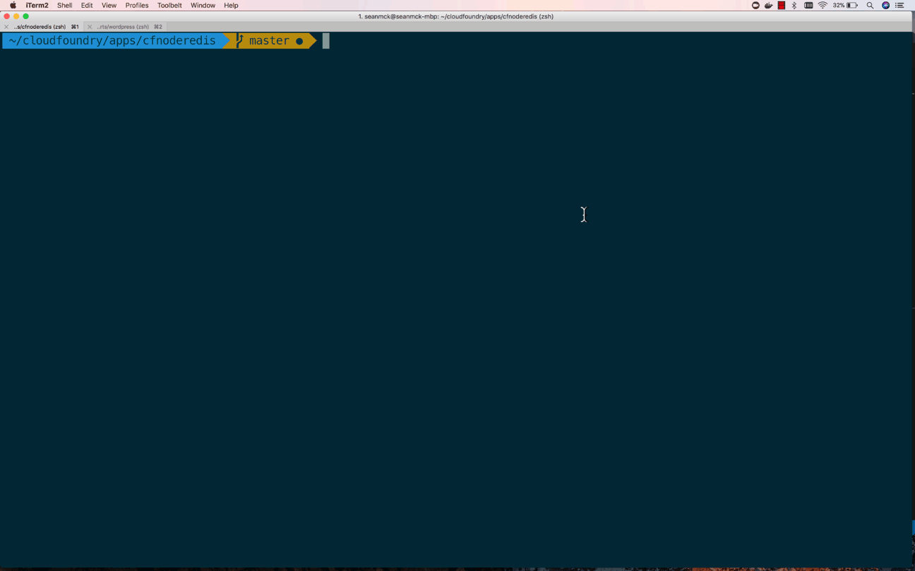
Open Service Broker for Azure (OSBA)
Azure Container Service (AKS)
OSBA in action
Azure Container Instances (ACI)
Azure Container Registry
Open Service Broker API (OSBA)
Release Automation Tools

Slide 50
Open Service Broker for Azure (OSBA)
Azure Container Service (AKS)
Getting started with ease
Azure Container Instances (ACI)
$ helm repo add azure Azure/helm-charts
$ helm install azure/service-broker
$ helm install azure/wordpress
Azure Container Registry
Open Service Broker API (OSBA)
Release Automation Tools

Slide 51
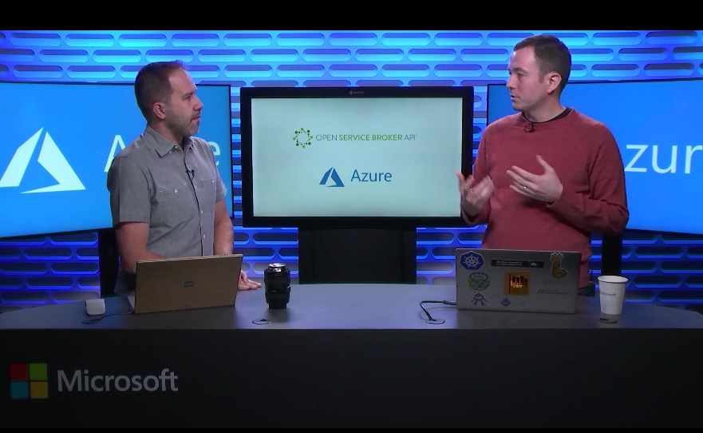
Open Service Broker for Azure (OSBA)
Azure Container Service (AKS)
Resources
Azure Container Instances (ACI)
Open Service Broker for Azure
OSBA announcement blog
OSBA on GitHub
Integrating with Azure-managed services using OSBA
Azure Container Registry
Open Service Broker API (OSBA)
Release Automation Tools

Slide 52
Release automation tools
Azure Container Registry
Open source community
Azure Container Service (AKS)
Release automation tools
Containers 101
Getting started
Azure container technology
Open Service Broker for Azure (OSBA)
Customer success stories
Container orchestration
Azure Container Instances (ACI)

Slide 53




Release automation tools
Azure Container Service (AKS)
Simplifying the Kubernetes experience
Azure Container Instances (ACI)
Azure Container Registry
Open Service Broker API (OSBA)
Streamlined Kubernetes development
The package manager for Kubernetes
Event-driven scripting for Kubernetes
Visualization dashboard for Brigade
Release Automation Tools

Slide 54
Release automation workflow
Azure Container Service (AKS)
New code directory
Create a code file
Draft creates a dockerfile and a Helm chart for service composition
Azure Container Instances (ACI)
New directory
Add a code file
Draft create
Azure Container Registry
Yes
Does it work?
Git push
Draft commit
Draft up
Open Service Broker API (OSBA)
No
Deploy code container chart
CI/CD
Release Automation Tools
Draft helps devs get running
Draft helps devs and operations iterate on containers and services
Artifacts push to cloud, controlled by CI/CD processes

Slide 55
Release automation workflow
Azure Container Service (AKS)
Once developers are up and running—or working on a service that is in a complex system—Draft ALSO helps devs ignore artifacts and focus on code
Azure Container Instances (ACI)
Get clone
Draft pack-reps
Draft create
Azure Container Registry
Yes
Does it work?
Git push
Draft up
Open Service Broker API (OSBA)
No
Debug
CI/CD
Release Automation Tools
Draft helps devs get running
Draft helps devs and operations iterate on containers and services
Artifacts push to cloud, controlled by CI/CD processes

Slide 56
Release automation workflow
Azure Container Service (AKS)
Create
Azure Container Instances (ACI)
Draft create
Have code?
No
New
Draft page
Azure Container Registry
Yes
Builds image/config. to be deployed
Staged?
Yes
Code
Container
Configuration
Draft create or Draft create-pack (if specific artifacts exist)
Deploy image (AKS)
Deploy to staging
No
Open Service Broker API (OSBA)
Push image
Canary deploy to production
CD: No staging
No
Testing good?
Move to dev cluster
Change
Code
Container
Configuration
Actual development, Draft up/connect iteration
The building process: Brigade, Jenkins, VS TS
Build container
Telemetry successful?
Rollback
Yes
No
2 factor authentication
Push to production as canary
Release Automation Tools
Yes
Git push
Pull code
Rollout
Code/artifacts ready

Slide 57

Draft
Azure Container Service (AKS)
Simple app development and deployment – into any Kubernetes cluster
Azure Container Instances (ACI)
Azure Container Registry
Open Service Broker API (OSBA)
Simplified development
Using two simple commands, developers can now begin hacking on container-based applications without requiring Docker or even installing Kubernetes themselves
Language support
Draft detects which language your app is written in, and then uses packs to generate a Dockerfile and Helm Chart with the best practices for that language
Release Automation Tools

Slide 58

Draft
Azure Container Service (AKS)
Draft in action
Azure Container Instances (ACI)
Azure Container Registry
Open Service Broker API (OSBA)
Release Automation Tools

Slide 59
Helm
Azure Container Service (AKS)
The best way to find, share, and use software built for Kubernetes
Azure Container Instances (ACI)
Azure Container Registry
Manage complexity
Charts can describe complex apps; provide repeatable app installs, and serve as a single point of authority
Easy updates
Take the pain out of updates with in-place upgrades and custom hooks
Simple sharing
Charts are easy to version, share, and host on public or private servers
Rollbacks
Use helm rollout to roll back to an older version of a release with ease
Open Service Broker API (OSBA)
Release Automation Tools

Slide 60

Helm
Azure Container Service (AKS)
Helm Charts helps you define, install, and upgrade even the most complex Kubernetes application
Azure Container Instances (ACI)
services
ci
db
Azure Container Registry
load balancer
custom
…
Chart.yml
Open Service Broker API (OSBA)
Release Automation Tools

Slide 61
Brigade
Azure Container Service (AKS)
Run scriptable, automated tasks in the cloud — as part of your Kubernetes cluster
Azure Container Instances (ACI)
Azure Container Registry
Open Service Broker API (OSBA)
Simple, powerful pipes
Each project gets a brigade.js config file, which is where you can write dynamic, interwoven pipelines and tasks for your Kubernetes cluster
Runs inside your cluster
By running Brigade as a service inside your Kubernetes cluster, you can harness the power of millions of available Docker images
Release Automation Tools

Slide 62
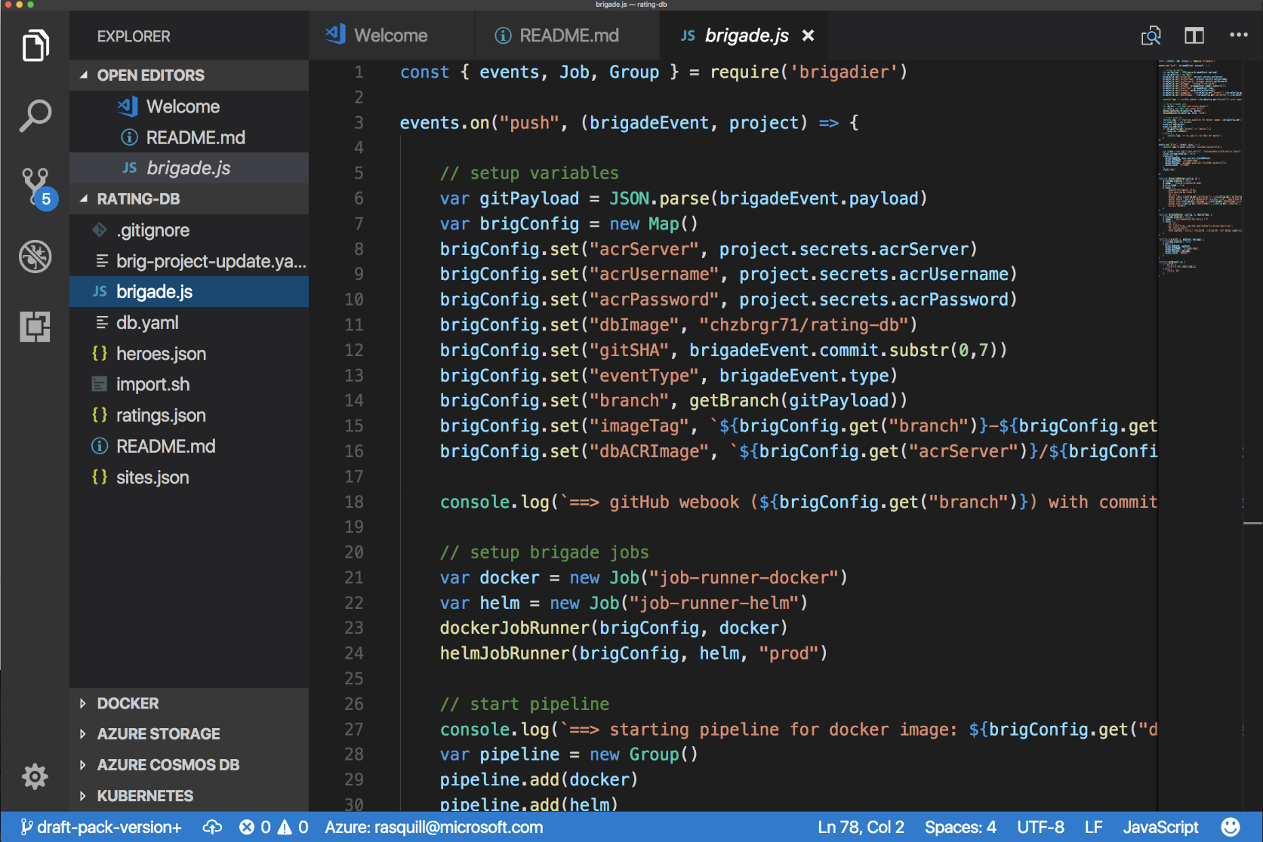
Brigade
Azure Container Service (AKS)
Brigade in action
Azure Container Instances (ACI)
Azure Container Registry
Open Service Broker API (OSBA)
Release Automation Tools

Slide 63
Kashti
Azure Container Service (AKS)
A simple UI to display build results and logs
Azure Container Instances (ACI)
Azure Container Registry
Simple visualizations
A web dashboard for Brigade, helping to easily visualize and inspect your Brigade builds
Driving deep insights
Make Brigade DevOps workflows— projects, scripts, and jobs—and their events visible instantly
Open Service Broker API (OSBA)
Release Automation Tools

Slide 64
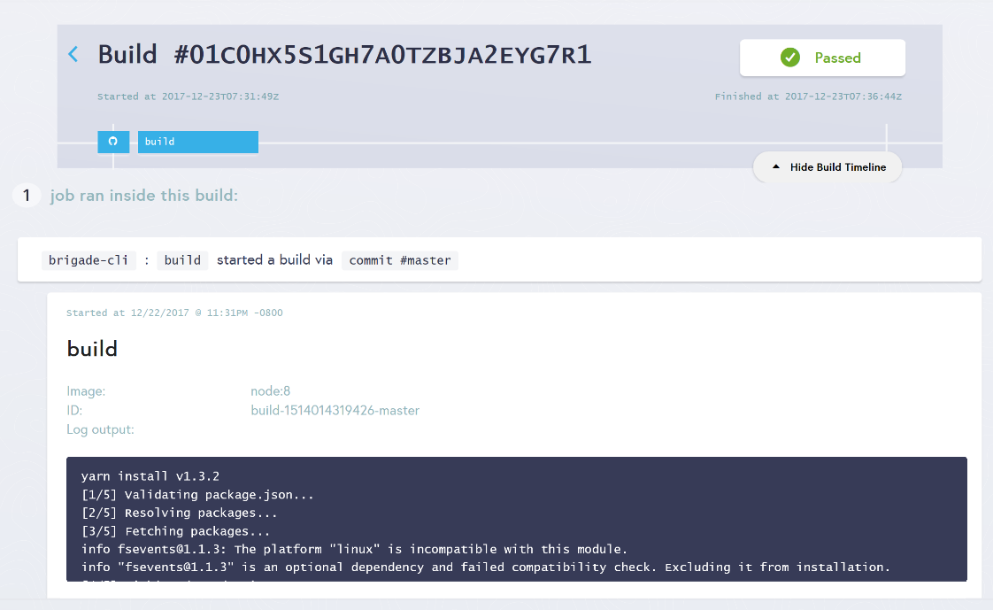
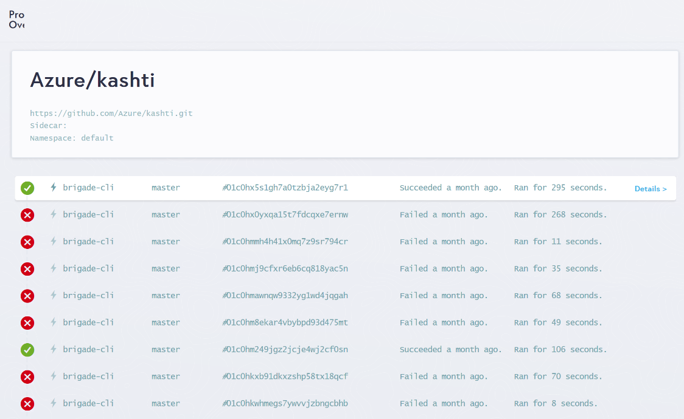
Kashti
Azure Container Service (AKS)
Dashboards for Brigade pipelines
Azure Container Instances (ACI)
Azure Container Registry
Open Service Broker API (OSBA)
Release Automation Tools
Builds dashboard
Events log

Slide 65
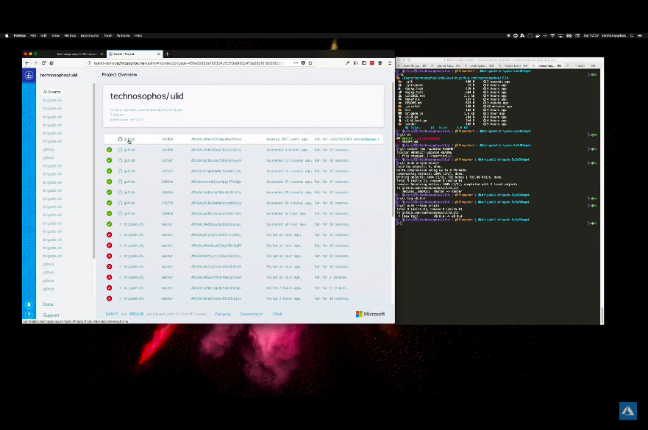
Release automation tools
Azure Container Service (AKS)
Resources
Azure Container Instances (ACI)
Brigade Demo with Kashti dashboard
Draft webpage
Helm webpage
Brigade webpage
Kashti announcement blog
Azure Container Registry
Open Service Broker API (OSBA)
Release Automation Tools

Slide 66

Open source community
Azure Container Registry
Open source community
Azure Container Service (AKS)
Release automation tools
Containers 101
Getting started
Azure container technology
Open Service Broker for Azure (OSBA)
Customer success stories
Container orchestration
Azure Container Instances (ACI)

Slide 67

Community culture
Open source container code contributions
Numerous open source project builds
Open source community leadership

Slide 68
Customer success stories
Azure Container Registry
Open source community
Azure Container Service (AKS)
Release automation tools
Containers 101
Getting started
Azure container technology
Open Service Broker for Azure (OSBA)
Customer success stories
Container orchestration
Azure Container Instances (ACI)

Slide 69


Energy company electrifies pace of innovation and expansion
Ambit Energy provides electricity and natural-gas services in deregulated markets around the world. It uses technology as a competitive differentiator, employing microservices, DevOps, and continuous deployment to speed software development. To stand up infrastructure just as quickly, Ambit uses Microsoft Azure services such as Azure Container Service, together with infrastructure as code and open source technologies, to completely automate infrastructure provisioning. By implementing Azure, Ambit can move dramatically faster to enhance its services and enter new markets. Infrastructure redundancy is flexible and worry-free. And costs are 22 percent lower, which helps Ambit compete in the crowded electricity market. Because Ambit’s cloud journey is gradual, it appreciates the fact that Azure is a great hybrid-cloud enabler, connecting easily to Ambit datacenters.
Products and services
Organization size
Industry
Country
Business need
Microsoft Azure Container Service
1,000 employees
Power and utilities
United States
Optimize operational efficiency

Slide 70


Siemens Health leverages technology to connect medical devices to the cloud through AKS
Digitization and networking between healthcare providers and software development companies are essential to value-based care. Moving from the development of value-added services into becoming more of a platform provider, it became important for Siemens to adopt a microservices approach to application delivery. To that end, Siemens adopted Azure Container Service (AKS) to run their microservices-based apps. AKS puts Siemens in a position not only to deploy business logic in Docker containers—including the orchestration—but also enables them to use an applicant gateway and API management to manage exposure, control, and to meter the access continuously. With their cloud-based development approach, Siemens has driven newfound product development agility. This project is already having a positive impact within the healthcare industry.
Products and services
Organization size
Industry
Country
Business need
Microsoft Azure Container Service
100,000+ employees
Healthcare
Germany
Faster application development

Slide 71
Getting started
Azure Container Registry
Open source community
Azure Container Service (AKS)
Release automation tools
Containers 101
Getting started
Azure container technology
Open Service Broker for Azure (OSBA)
Customer success stories
Container orchestration
Azure Container Instances (ACI)

Slide 72

Get started today!
Sign up for Azure
Spin up an AKS cluster
Check out resources

Slide 73
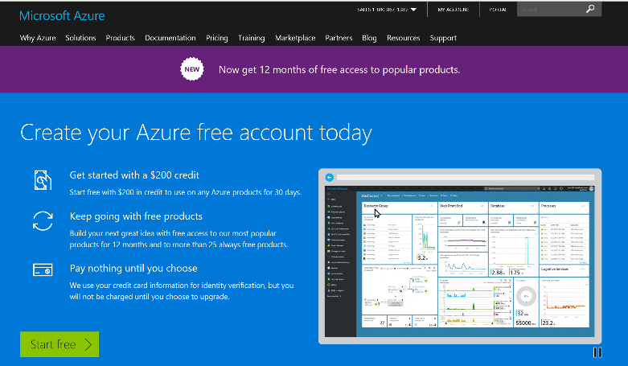
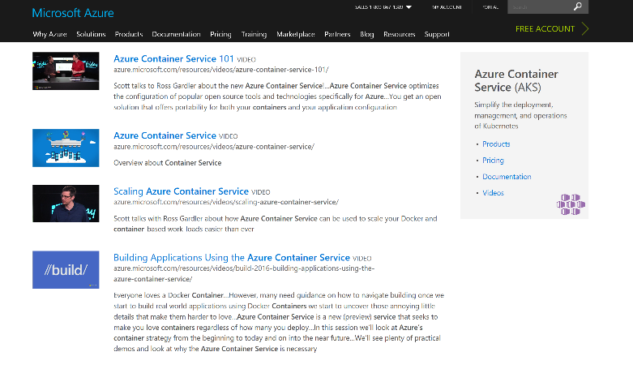
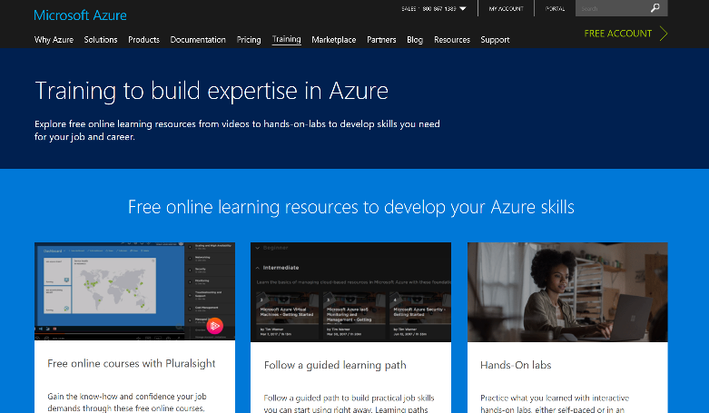
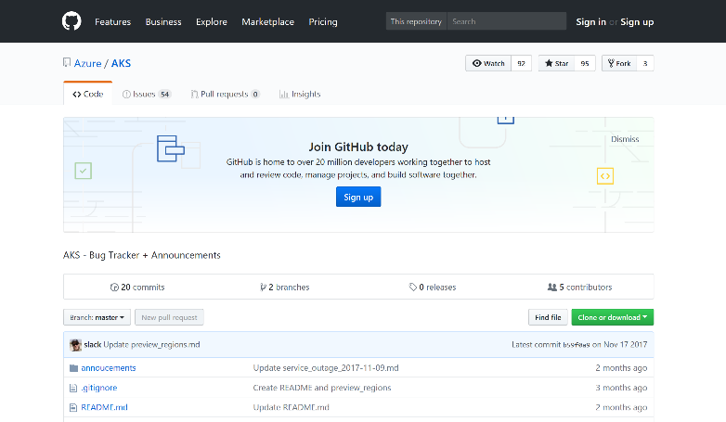
Check out resources
Azure Container Service (AKS)
Azure Container Instances (ACI)
Azure Container Registry
OSBA announcement blog
Draft webpage
Helm webpage
Brigade webpage
Kashti announcement blog
Sign up for a free Azure account
Check out the Azure container videos page
Hone your skills with Azure training
Get the code from GitHub

